Slide 1
Travel Coordinator Meeting Friday, December 14, 2018
Presented and Prepared for by:

Slide 2
Introduction of Globetrotter Staff
Michael Buttner, CEO
Kim Noppenberger, Manager, Reservations
Jonathan Godfrey, Manager, Groups & Meetings

Slide 3
Finding Your Airline Confirmation Number on Your TripCase Email

Slide 5
Necessary Information to Make an Airline Reservation and Issue the E-Ticket
Dates of travel
From where to where (preferred airport)
Name on ID using at the airport
Cell phone contact of passenger
Date of birth, TSA Pre-check Number
Frequent Flyer Number
Seat Preference
Passport Information
3.

Slide 6
Other important notes:
If the department does not have a direct bill set up with a car rental company, the reservation is made but the traveler must pay at counter.
Review the itinerary we email to you, within 24 hours, we can make changes, after receiving a void waiver. If not it is the airlines fees and additional collection

Slide 7
The Importance of Reviewing the Itinerary Within 24 Hours of Receiving
Look for the correct dates
Look for the correct cities
Look for the spelling of passenger on the ticket
Look for the rental car reservation
Look for the hotel reservation
NOTE: ERRORS can be corrected within 24 hours of issuing the e-ticket on most airlines with a mimimal cost. After 24 hours, the cost of changing is now the state agency department.

Slide 8
An Authorization is Required to Issue a Ticket
The State of Maryland requires that Globetrotter have an authorization to issue an airline ticket.
Without an authorization, does Globetrotter issue the ticket? NO

Slide 9
Requesting a Car Rental Direct Bill Application

Slide 10
Updating Travel Coordinators and Credit Cards
Most agencies are doing a terrific job with keeping Globetrotter updated.
Globetrotter must be notified with the following:
Coordinator change
Credit card change
Agency Travel Policy change

Slide 11
Using the 24 Hour Emergency Line when it is not an emergency
Calls Per Month $ 17.50 Per Call
Refer Call Back To Agency During Agency Business Hours $ 4.00 Per Call
Mid-Day Assist – Weekdays 9:00 am – 2:00 pm PST $ 1.00 Off Applicable Call Fee On Preferred Calls
Additional Service Charges
$ Ticketing $ 12.50 Per Ticket Request
Exchanges $ 25.50 Per Exchange Request
Exchanges Requiring Authorization $ 30.00 Per Exchange Request
Voids $ 10.00 Per Voided Ticket Request

Slide 12
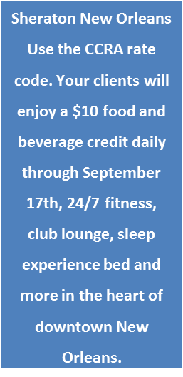
Current Travel Discounts
Southwest Airlines
Avis and Budget
Enterprise
CCRA, Ensemble and THOR hotel discounts

Slide 13
Other Approved Services Offered by Globetrotter
Meeting Planning
Meeting Registration
Group Hotel Reservations
Ground Transportation – Buses
Vacation, Cruises and Tours
Travel Insurance

Slide 14
Thank You for Your Time
Any Questions? info@globetrottermgmt.com

